Slide 1
Data Mining Cup 2017 Revenue Forecast of Mail Order Pharmacy
1st intermediate presentation
Data and Web Science Group
University of Mannheim
Daniel Helfer, Timo Sturm, Alexander Brinkmann, Steffen Terheiden, Florian Schrage, Nancy Kunath, Liane Gybas, Christoph Wagner
25.04.2017

Slide 2
DMC 17 - Challenge
Original task
Two step model
Adjusted two step model
Predict the type of user action (Click/Basket =1 vs. Order =1)
Predict the type of user action (Click/Basket =1 vs. Order =1)
Predict the revenue for every user action
Predict the revenue for all “order” actions
Predict the quantity for all “order” actions
Regression problem
Classification problem

Slide 3

Overview
Selection
Preprocessing
Transformation
Data Mining
Evaluation & Interpretation
Available data
…….
Target
Data
Preprocessed Data
Transformed Data
Patterns
Adopted from Fayyad et al. (1996)

Slide 4
Preprocessing
Feature Understanding
Feature Engineering
Selection
Preprocessing
Transformation
Data Mining
Evaluation & Interpretation
Available data
…….
Target
Data
Preprocessed Data
Transformed Data
Patterns
Adopted from Fayyad et al. (1996)

Slide 5
Feature Understanding and Engineering
PID
Train Data
contains 21,928 unique PIDs
contains 1503 unique PIDs that are not contained in the class data
Class Data
contains only 20,525 unique PIDs (1,403 PIDs less)
contains 100 unique PIDs that are not contained in the train data
Might make sense to handle these products differently
AdFlag
Indicates if an item is part of an advertising campaign
~ 1/3 of the products get advertised
has a large influence on whether a product
gets ordered
Consequence: advertisement increases
the mean quantity:
Advertising: 0.431
No Advertising: 0.317
 | Advertising | No Advertising
Click | 44.4% | 63.5%
Basket | 23.3% | 14%
Order | 32.2% | 22.5%

Slide 6
Feature Understanding and Engineering
Revenue, Price, CompetitorPrice & RRP: New Features
Features with absolute values
Quantity: quantity of ordered products
diffPriceCompetitorPrice: difference between price and competitorPrice
diffRrpPrice: difference between rrp and price
diffRrpCompetitorPrice: difference between rrp and competitorPrice
meanPricePerProduct: mean price for each PID over time
Features with relative values
ratioDiffPriceCompetitorPriceToPrice: ratio of diffPriceCompetitorPrice to price
ratioDiffPriceCompetitorPriceToCompetitorPrice: ratio of diffPriceCompetitorPrice to competitorPrice
Features with normalized values
Normalization of price, competitorPrice and rrp based on max price of all PIDs
Normalization of price, competitorPrice and rrp based on max price of single PID over time
Features with nominal values
actionType: indicates if the action was a click, basket or order in one single feature
factorizedRelationPriceCompetitorPrice: relation between price and competitor price (“higher”, “equal”, “lower”)

Slide 7
Feature Understanding and Engineering
Availability
indicates if product is available from 1 (“in storage”) to 4 (“not available”)
very unbalanced:
1: 91.3 % of records (55.6% click, 17.6% basket, 26.8% order)
2: 6.7 % of records (75% click, 10.4% basket, 14.6% order)
3: 1.6 % of records (78% click, 12% basket, 10% order)
4: 0.4 % of records (99,8% click)
→ Correlation: The less a product is available, the less it gets ordered
Trend: In average, the products get less available over time:
Average day per status: 1: 49.8 > 2: 50.6 > 3: 51.1 > 4: 59.16
But: There are also many products without availability changes!
PharmForm
contains official German abbreviations for “dosage forms” (e.g. AMP = Ampulle)
Cleaning necessary: Contains case sensitive values which indicate the same (e.g. “Amp” & “AMP”)
Grouping: by mapping the abbreviations to their official definition (based on a catalog),
it’s possible to define new features based on physical conditions

Slide 8
Feature Understanding and Engineering
genericProduct
indicates if it is a generic drug which is equivalent to a brand-named product (German: „Nachahmerprodukt“)
has always salesIndex = 40
In average, generic products are cheaper than non-generic products
campaignIndex
We believe that this might be an indicator for something like possible campaign restrictions
Therefore, the missing values should be seen as an additional class indicating „NONE“!
very unbalanced:
Value | A | B | C | Missing
Distribution | 1.588 % | 3.349 % | 1.135 % | 93.93 %

Slide 9
Feature Understanding and Engineering
Unit
Very unbalanced!
Possible binnings:
ST, NotSt (Distr: 0.4834 | 0.5166)
ST, ML, REST (Distr: 0.4834 | 0.3367 | 0.1799)
Transformations possible (e.g. KG to G, L to ML, …)
Content
Represents quantities w.r.t. the corresponding unit value
e.g. 3X10 as “3 times 10 STs (pieces)” | 20X5.7 as “20 times 5.7 gramm” | 1.5 as “1 time 1.5 meters”
2 error Values: “PAK” , “L 125”
New possible features:
numberOfPackages: first number of the content values
quantityByPackage: first number of the content values
totalNumberOfPieces: numberOfPackages * quantityByPackage
pricePerPiece: price / totalNumberOfPieces
competitorPricePerPiece: competitorPrice / totalNumberOfPieces
rrpPerPiece: rrp / totalNumberOfPieces
unit | ST | P | G | KG | ML | L | CM | M
absolute Distribution | 1332256 | 19824 | 472390 | 178 | 927879 | 2613 | 272 | 591
relative Distribution | 0.4834 | 0.0072 | 0.1714 | 0.0001 | 0.3367 | 0.0009 | 0.0001 | 0.0002

Slide 10
Feature Understanding and Engineering
Products
Entries (in items.csv) with different PIDs can be the same product in different sizes
e.g. Aspirin as a 20 or 50 pieces pack
Have identical values besides pid and rrp
Entries (in items.csv) with different PIDs can be variations of a single base product
e.g. a cough sweets in different flavors
Have identical values besides pid
We can introduce a feature to link these entries: product
Resulting hierarchy: productGroup >> product >> pid
Time
No real timestamp available, only an increasing number given
Possible hierarchy: month >> monthHalf >> week >> weekday* >> day
* No actual week days, but numbers 1-7

Slide 11
Feature Understanding and Engineering
Top Revenue Products
Furthermore:
The most expensive products get ordered very rarely
82 products always get ordered directly (no click or basket events)
Might be products with forced prescription
PID | Total Revenue | Single Price | Sold x times | Rank | Sold in x transactions | Rank
16641 | ~115.400,00 | 18,70 (expens.) | ~6.200 | 6th | ~4.900 | 2nd
17226 | ~89.300,00 | 25,19 (expens.) | ~3.500 | 16th | ~2.100 | 22nd
2491 | ~60.200,00 | 2,70 (cheap) | ~22.300 | 1st | ~8.500 | 1st
17316 | ~59.100,00 | 35,05 (expens.) | ~1.700 | 52th | ~1.500 | 39th
12940 | ~56.000,00 | 24,09 (expens.) | ~2.300 | 34th | ~1.500 | 43th
Low Revenue Products
~ 3100 products (14 %) get not ordered at all, so do not generate any revenue!
Frequently vs. Rarely ordered products:
A slight negative correlation between the RRP and the ratio of order to non-order events exists!

Slide 12
Data Mining and Evaluation
Time Dependent Behavior
Baseline
Performance Measurement
Selection
Preprocessing
Transformation
Data Mining
Evaluation & Interpretation
Available data
…….
Target
Data
Preprocessed Data
Transformed Data
Patterns
Adopted from Fayyad et al. (1996)

Slide 13
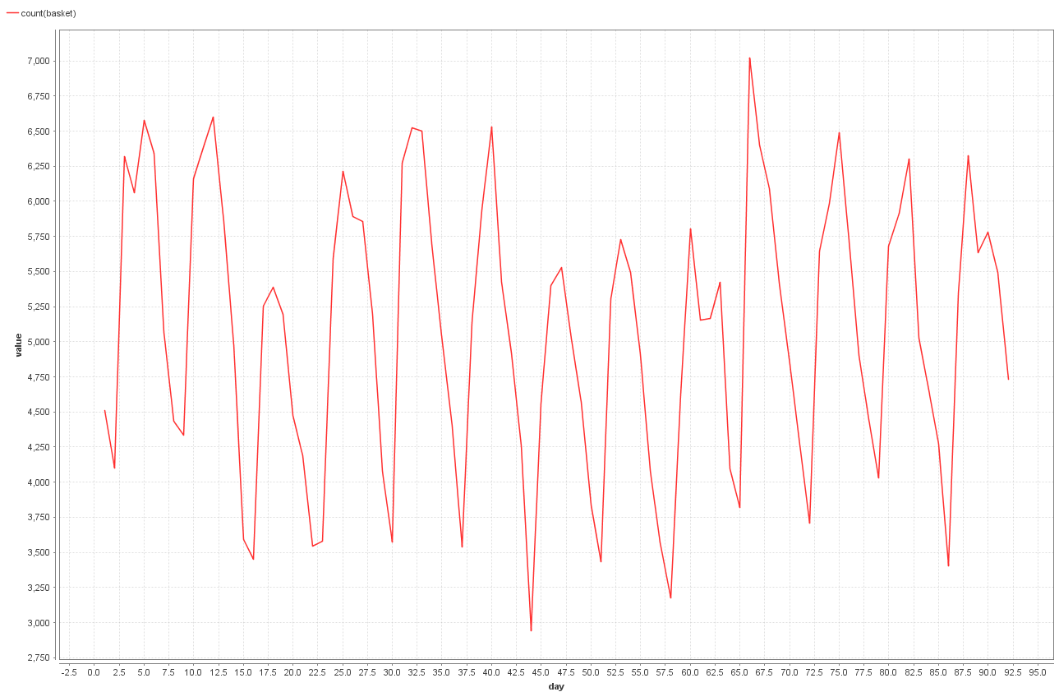
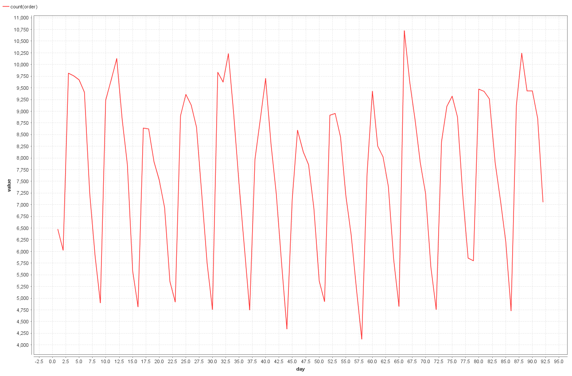
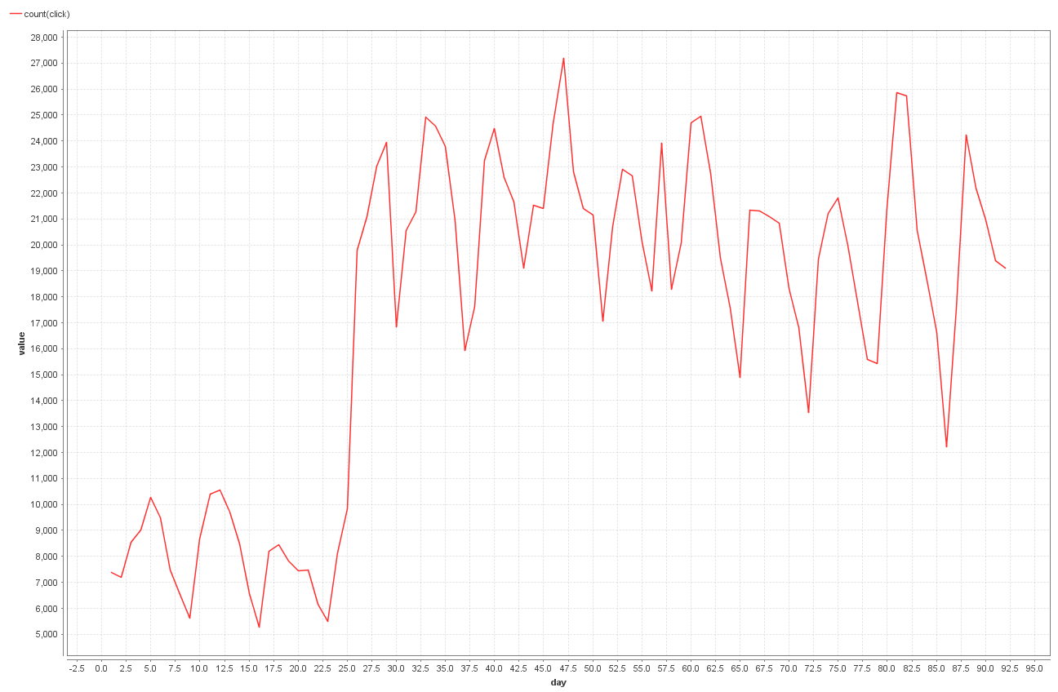
Evaluation of Time Dependent Behavior
Basket actions per day
Order actions per day
Click actions per day
Between day 25 to 26 there is a steep increase (+ 10,000) of clicks
Might be a sign for incomplete data in the first month

Slide 14
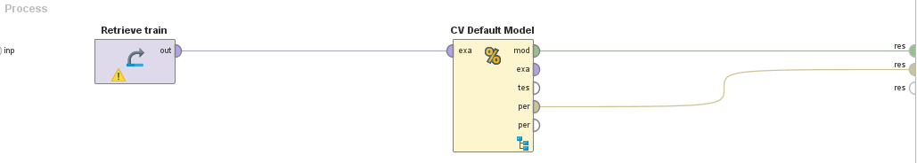
Baseline
Performance of the Default Model
Median: RMSE* = 10.904
Average: RMSE = 10.238
For comparison, basic Gradient Boosted Tree: RMSE = 9.679
*RMSE : Root Mean Squared Error

Slide 15
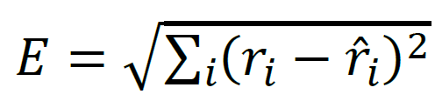
Performance Measurement
Evaluation takes place on example level
Difference between actual value and prediction is squared
Crucial to predict
high revenue transactions correctly
High quantity with decent price
High price
Medium high quantity with medium high price
highly frequent transactions correctly
i.e. no revenue flags

Slide 16
Questions?
Feel free to ask!

